Slide 1
C# Session-3
By Muhammad Muneeb Ullah Khan

Slide 2
C# Methods
A method is a block of code which only runs when it is called.
You can pass data, known as parameters, into a method.
Methods are used to perform certain actions, and they are also known as functions.
Why use methods? To reuse code: define the code once, and use it many times.

Slide 3
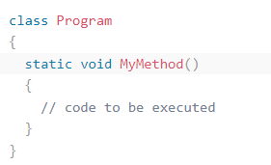
Create a Method
A method is defined with the name of the method, followed by parentheses (). C# provides some pre-defined methods, which you already are familiar with, such as Main() , but you can also create your own methods to perform certain.

Slide 4
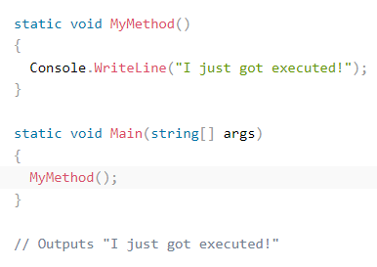
Call a Method

Slide 5
C# Method Parameters
Parameters and Arguments
Information can be passed to methods as parameter. Parameters act as variables inside the method.
They are specified after the method name, inside the parentheses. You can add as many parameters as you want, just separate them with a comma.

Slide 6
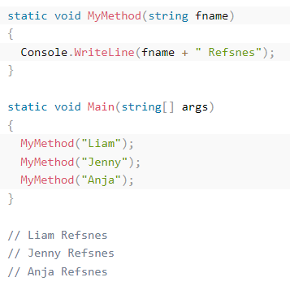
Parameters and Arguments

Slide 7
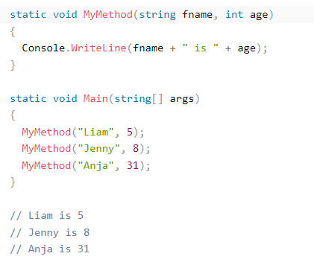
Multiple Parameters
You can have as many parameters as you like, just separate them with commas:

Slide 8
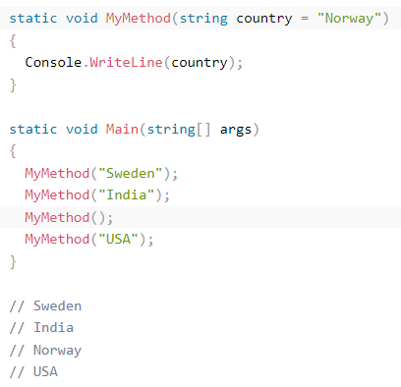
C# Default Parameter Value
You can also use a default parameter value, by using the equals sign (=).
If we call the method without an argument, it uses the default value ("Norway"):

Slide 9
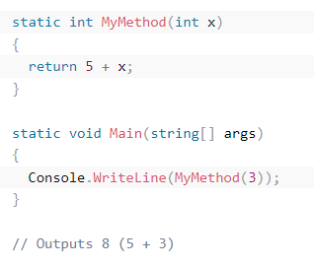
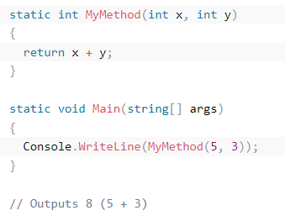
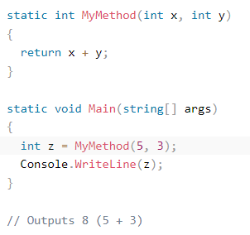
C# Return Values

Slide 10
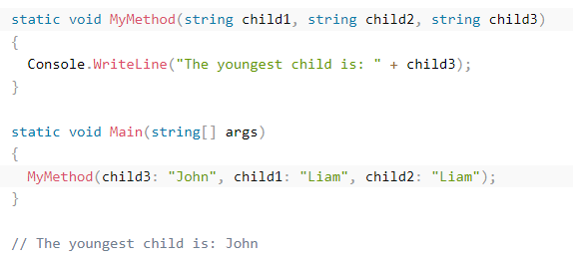
C# Named Arguments

Slide 11

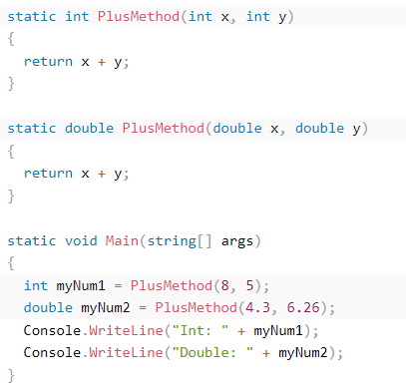
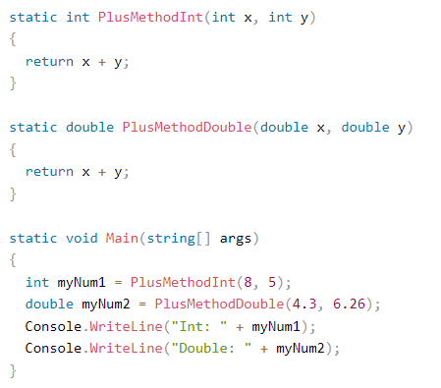
C# Method Overloading

